Slide 1



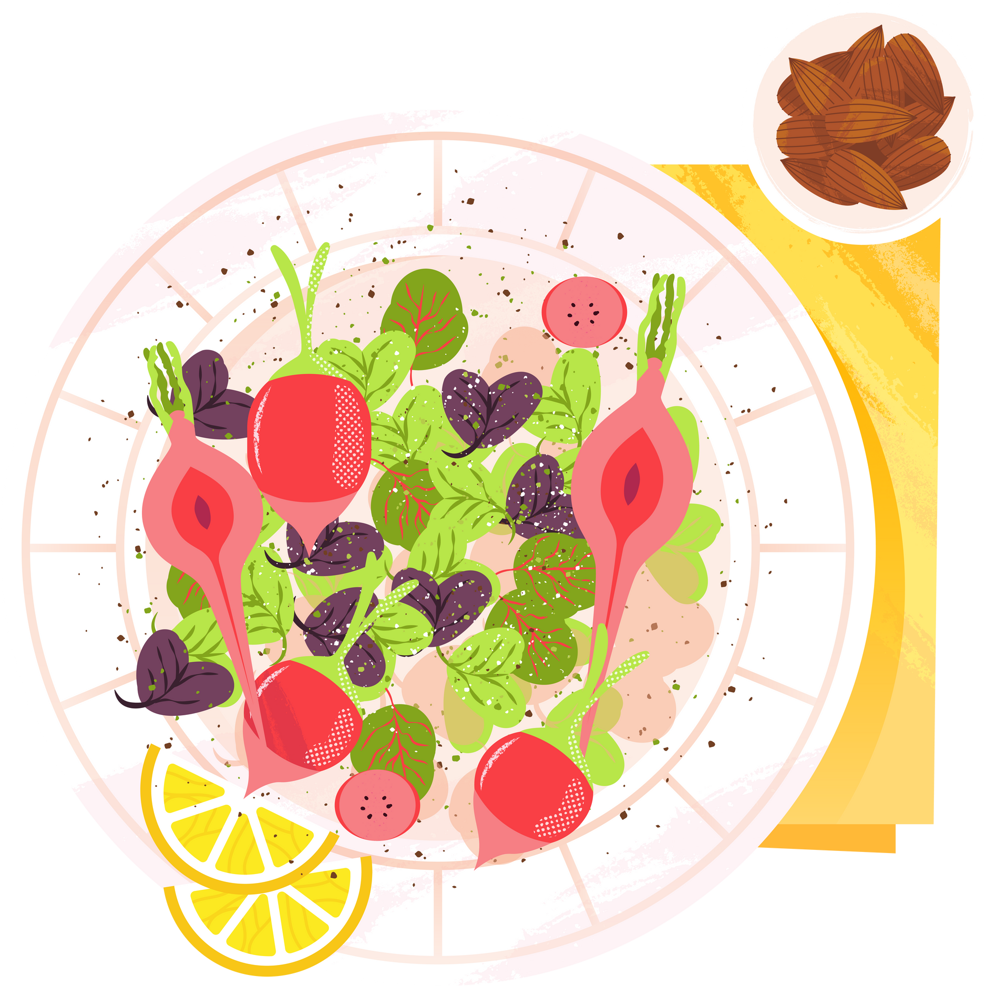


FOOD RECIPE BOOK
UPLOAD YOUR UNIQUE RECIPES
-BY KHUSHBOO GUPTA

Slide 2


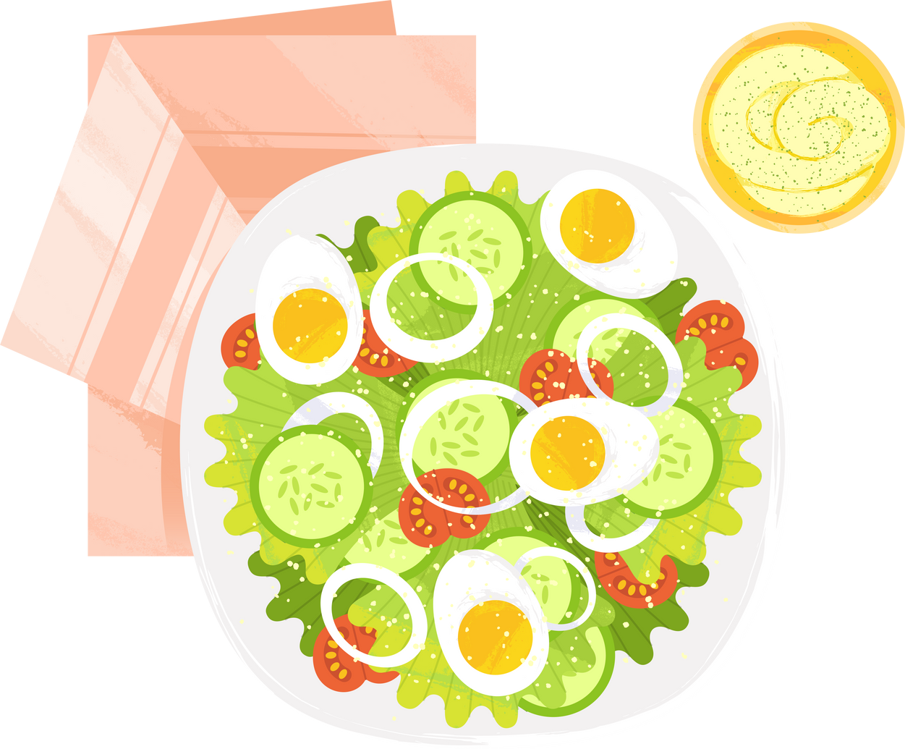
INTRODUCTION
Created using flask, HTML,CSS, and Mongodb
Components as :
Recipe Name
Ingredients
Instructions

Slide 3

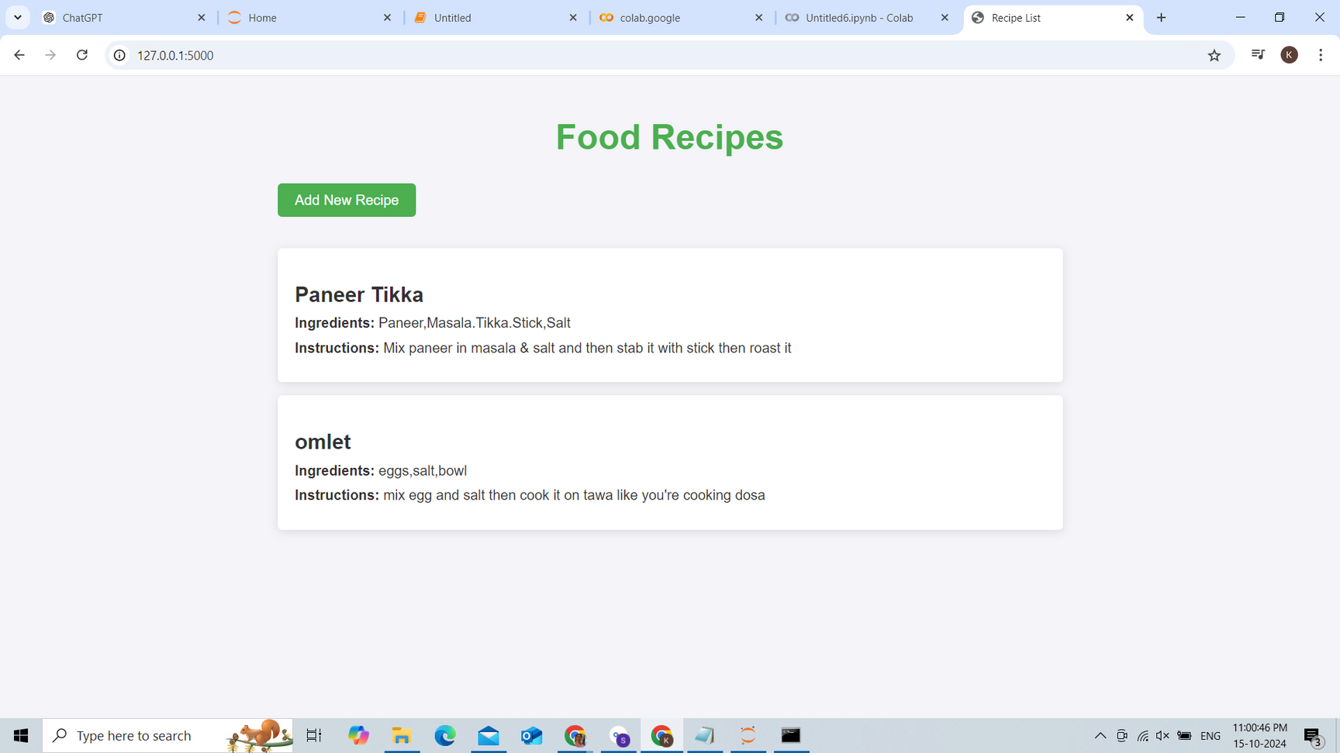

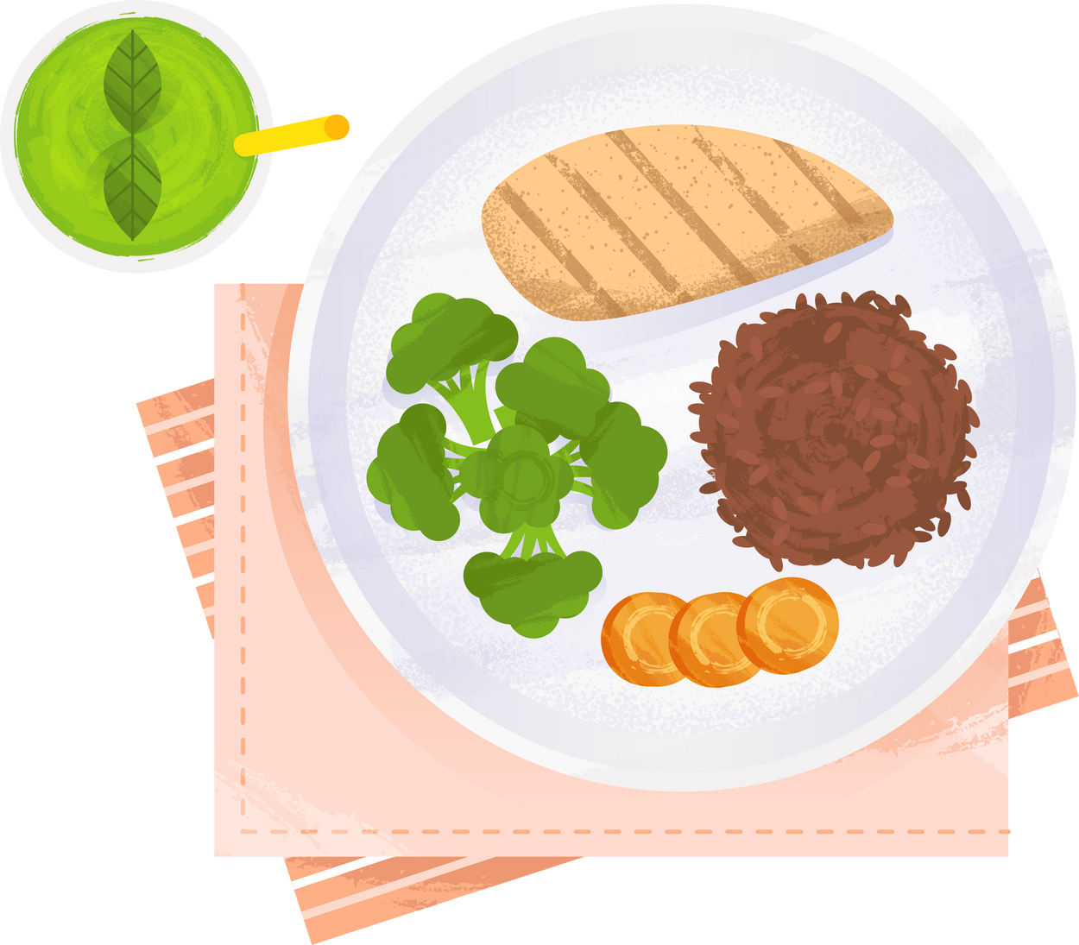

FRONT - END
WE CAN SEE THE RECIPES LIST THAT ARE STORED

Slide 4

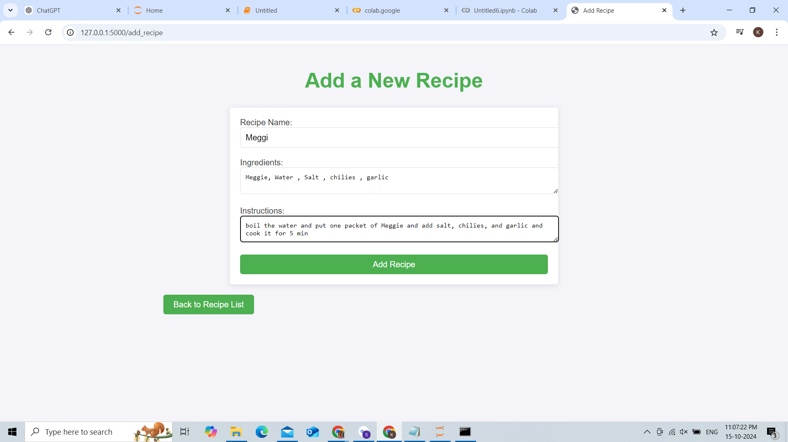
ADDING NEW RECIPE

Slide 5
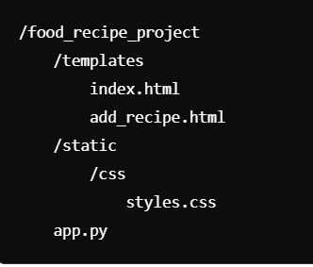
Folder Structure

Slide 6


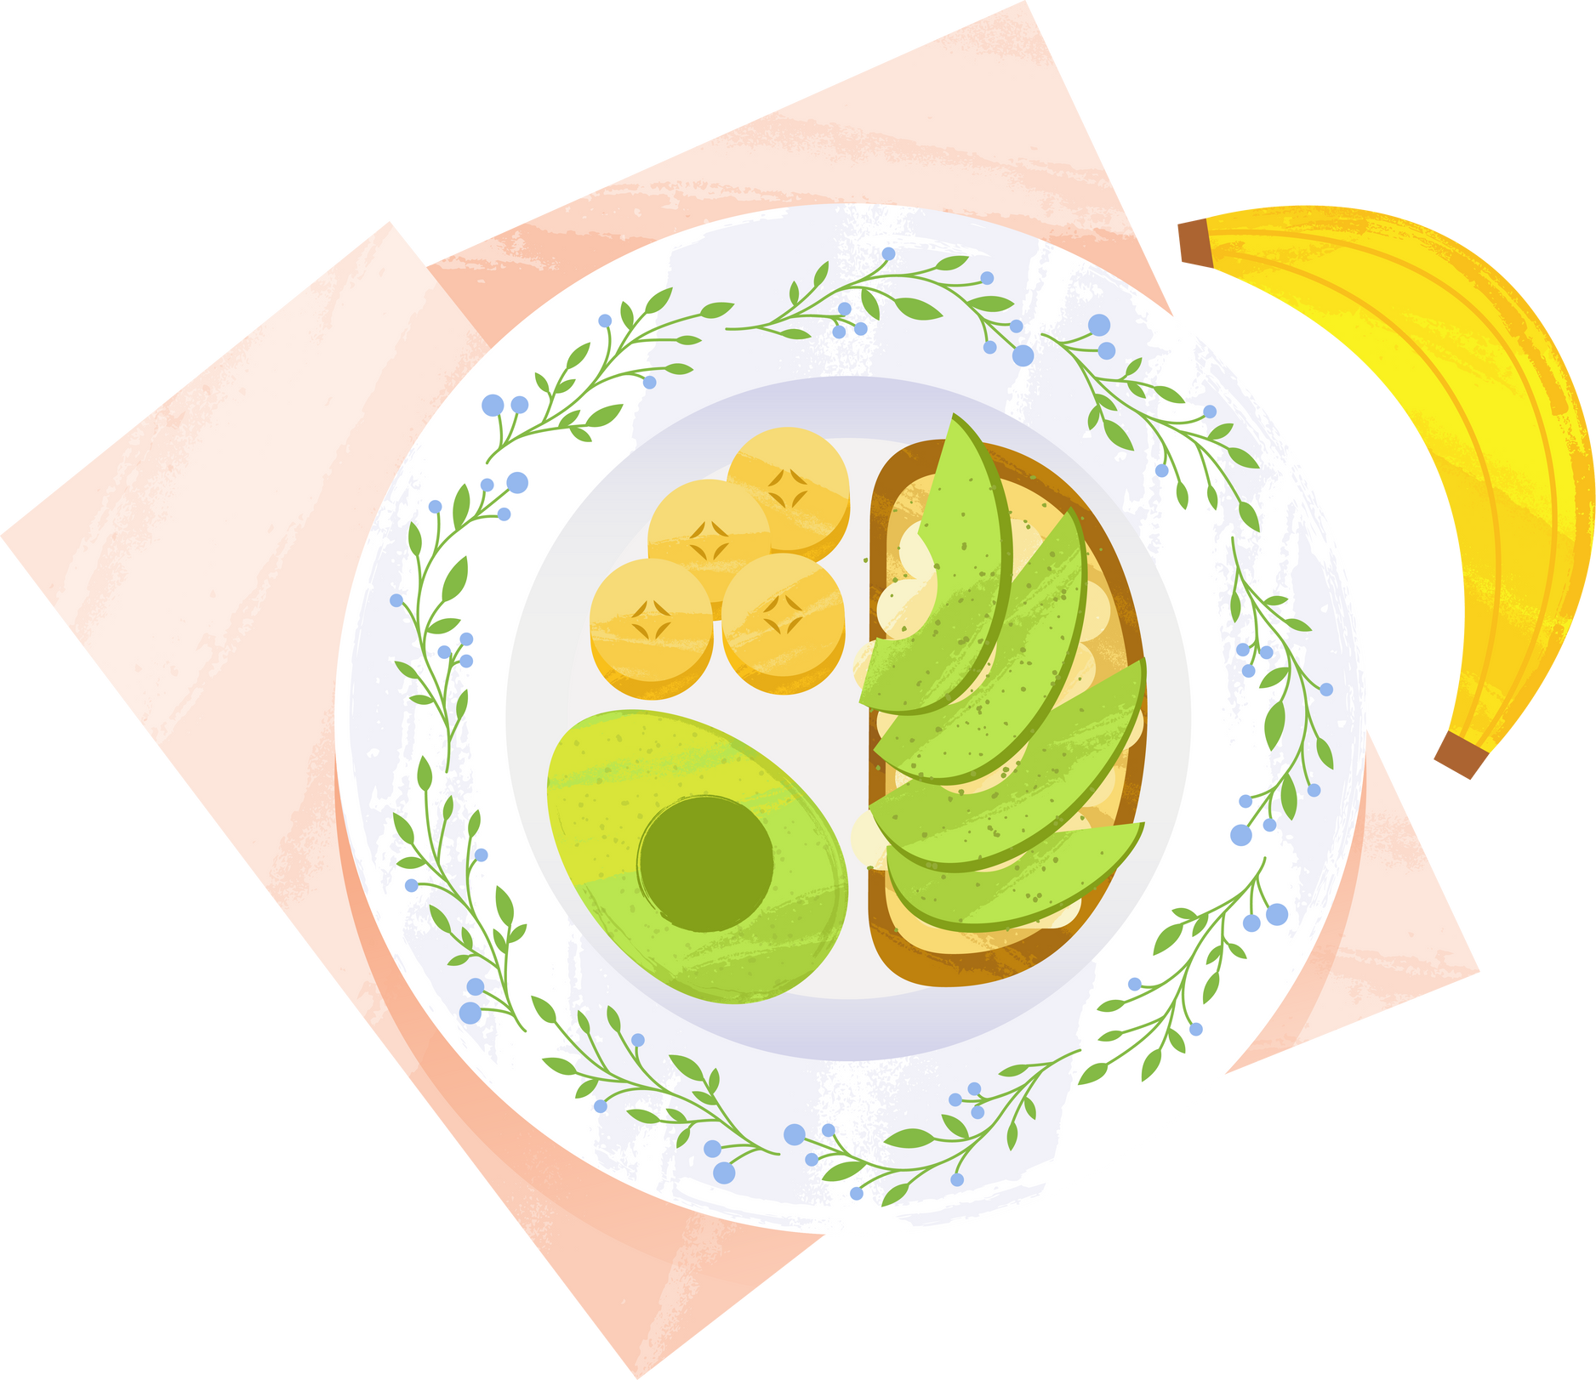

THANK YOU

